Slide 1
HOT TOPICS IN
HEALTH AND SAFETY

Slide 2
Who’s in the Room?

Slide 3
The Fight for Safe Workplaces
In 2012, 4,628 workers lost their lives on the job, and another 50,000 died from occupational diseases.
Over 8 million public employees STILL do not have safety and health protections on the job.
Since last convention, at least a dozen members were killed on the job
SO, WHAT ARE WE GOING TO DO ABOUT IT?
Notes:
Per Bureau of Labor Statistics Final count, April 22

Slide 4
What’s safety issues are going on in your local?

Slide 5
What’s H T-Health and Safety Update
Massachusetts passes public employee safety coverage
Updated hazard communication standard and the transition to Global Harmonization
New silica standard
Infectious disease update
OSHA emphasis on falls, safety stand-down
OSHA to convene SBREFA panel on infectious disease

Slide 6
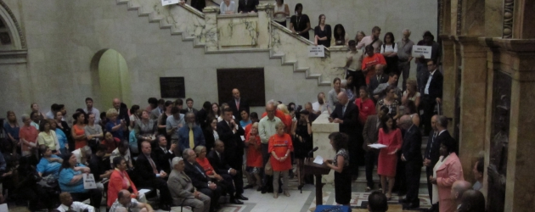
S.2195, “An Act Restoring the Minimum Wage and Providing Unemployment Insurance Reforms.”
Increases minimum wage
Insurance reforms
Extends OSH coverage to public employees

Slide 7
Global Harmonization and Right to Know
GHS has significantly changed the Hazard Communication Standard (Hazcom), 29 CFR 1910.1200
The previous Hazcom standard is performance based and covers these five elements:
Chemical inventory
Written program
Labels and labeling systems
Material safety data sheets (MSDS)
Training
Other chemical specific standards may
also be affected

Slide 8
What are the Major Changes?
Transition from performance oriented to a standardized approach.
Health, physical and environmental hazard criteria for substances and classification of mixtures.
Harmonized pictograms, hazard statements and signal words on labels.
16 section standardized safety data sheet
Notes:
Will affect nearly every AFSCME member in some way

Slide 9
Sample Label GHS

Slide 10
9 Pictograms

Slide 11
The Safety Data Sheet (SDS)
ORDER IS SPECIFIC AND REQUIRED!
Stability and reactivity
Health effects -Physical and chemical properties
toxicity
Ecological info*
Disposal
Transport
Regulatory information-optional
Other information incl. date of preparation or revision
Identification of substance or mixture and of the supplier
Hazard identification
Information on ingredients
First aid measures
Firefighting measures
Accidental release
Handling and storage
Exposure controls/PPE
Notes:
* Will not be required by OSHA-but will be required by EPA And certain states

Slide 12
Timetable for Revisions to HCS
WHEN? | WHAT? | WHO?
December 1, 2013 | Train employees on the new label elements and safety data sheet (SDS) format. | Employers
June 1, 2015* December 1, 2015 | Compliance with all modified provisions of this final rule, except: The Distributor shall not ship containers labeled by the chemical manufacturer or importer unless it is a GHS label | Chemical manufacturers, importers, distributors and employers
June 1, 2016 | Update alternative workplace labeling and hazard communication program as necessary, and provide additional employee training for newly identified physical or health hazards. | Employers
Transition Period to the effective completion dates noted above | May comply with either 29 CFR 1910.1200 (the final standard), or the current standard, or both | Chemical manufacturers, importers, distributors, and employers
Notes:
This is the timetable for when significant parts of the standard must be implemented by employers and manufacturers. Notice the training element must be completed by December 2013
Use pointer

Slide 13
Silica
Crystalline silica is a natural part of the earths crust and is a basic component of sand and granite
Breathing in silica particles can cause silicosis, a serious and debilitating disease
About 1.7 million workers are at risk
Highway and road workers can be exposed to silica dust during sandblasting, trenching activities, automotive repair and cement maintenance work

Slide 14
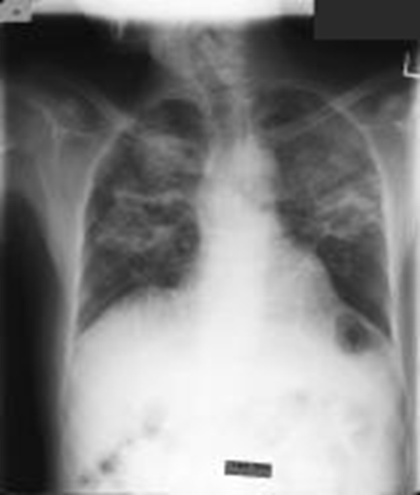
Silicosis
Breathing in silica dust causes scar tissue (fibrosis) and lumps (nodules) to form in the lungs
Scarring limits the ability of the lungs to expand and take oxygen from the air.
Early symptoms include shortness of breath, fever, and bluish skin around the ear lobes or lips
Later symptoms include fatigue, extreme difficulty breathing, pain in the chest, loss of appetite
There is no cure for silicosis
X-ray of a lung with silicosis
Notes:
More susceptible to lung cancer and TB
3 Kinds- simple chronic, accelerated, and acute.

Slide 15
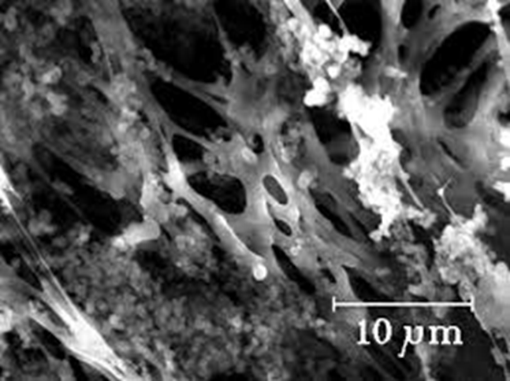
What Will the New Standard Say?
Reduce the permissible exposure limit (PEL) to 50 μg for both construction and gen. industry
Requires controls
Limits access to high exposures
Provide for medical exams
Provide for training
respirable silica

Slide 16
Controls for Silica
Engineering: Blasting cabinets, water sprays, local exhaust ventilation
Administrative: Identify all possible work assignments that can expose workers. Air monitor blasting operations. Train workers in techniques to control silica dust.
PPE: Where exposure can not be controlled by engineering controls, use a respirator approved for silica dust. A CE positive pressure abrasive blasting respirator is requires for sandblasting

Slide 17
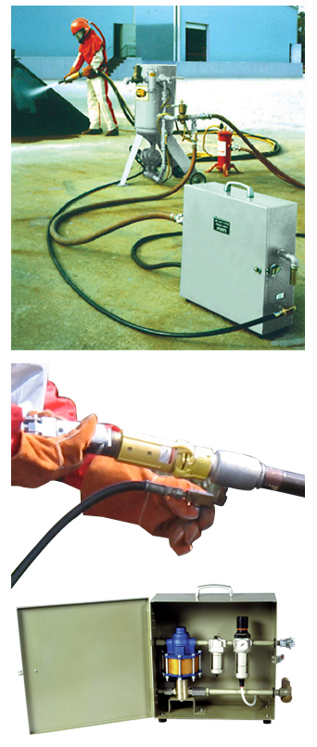
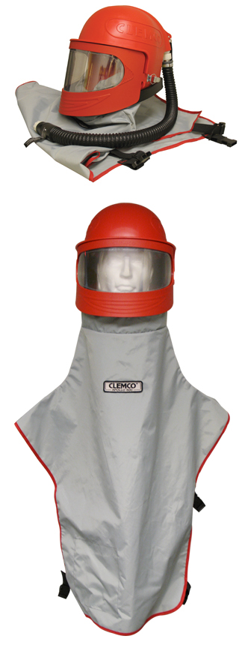
CE Positive pressure unit Wet Process Blasting System
Notes:
CE positive pressure respirator on left and a wet process blasting system on the right

Slide 18
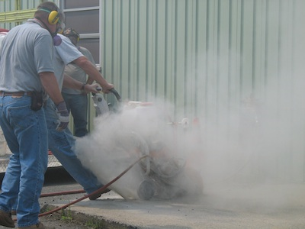
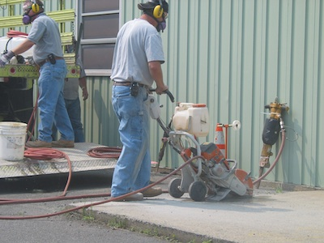
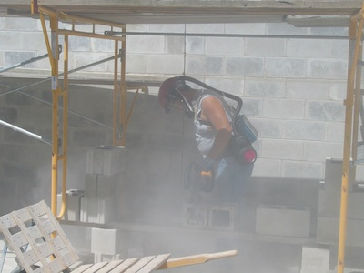
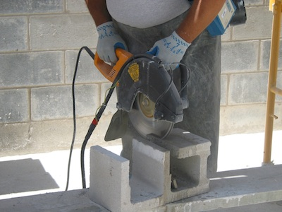
Controls
Walk-Behind Concrete Saw without Control
Walk-Behind Concrete Saw with Water Control

Slide 19
Status of the Silica Standard
Hearing completed; final briefs due in August
Senate Appropriations Committee
offer an amendment at the full committee Labor-HHS mark-up to block OSHA’s silica standard
If not blocked, standard should be out next year

Slide 20
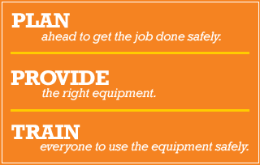
Fall Protection-Fall Safety Stand-down
Lack of fall protection the # 1 citation
Falls the leading cause of death in construction (284 in 2010)
OSHA emphasis program

Slide 21
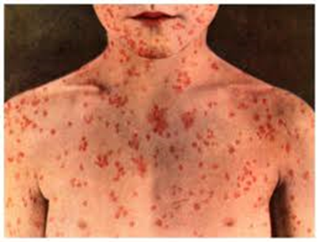
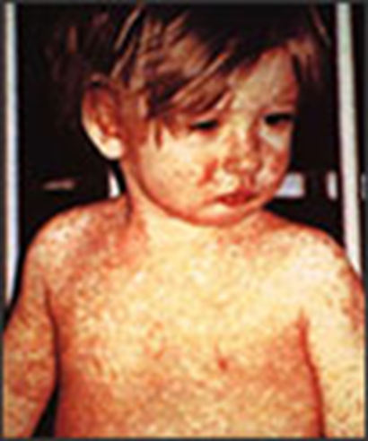
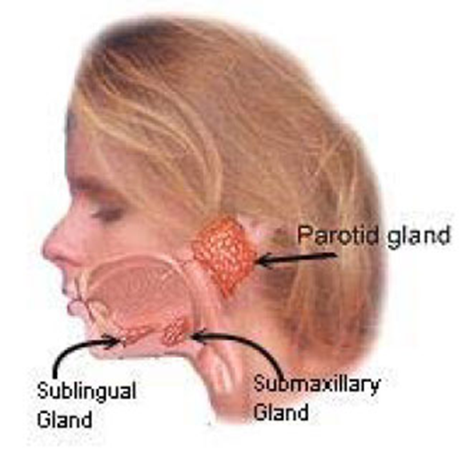
Recent outbreaks-measles mumps pertussis
CDC-highest rates of measles in 20 years
Multiple mumps outbreaks
Fordham State university
Pertussis-breakouts in CA 3 X’s
last years infection rate

Slide 22
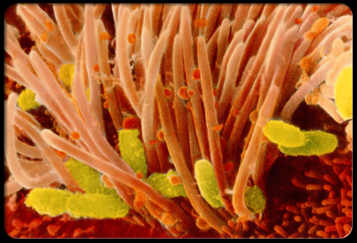
Pertussis: An Old Problem Making a Comeback
Also known as Whooping Cough
Caused by a bacteria B. Pertussis
Can occur at any age, but can be deadly in infants
Immunity drops w/age; booster recommended for teens and adults
48,000 cases and 18 deaths in 2012
http://www.pkids.org/diseases/pertussis.html
Notes:
Highly infectious, spread by mucus droplets. Transmittable from onset of symptoms up to three weeks and sometimes longer. Infectious for up to 5 days w/antibiotics.
Dtap vaccine required in NY
1 in 5 infants will be hospitalized with complications/often pneumonia. Of every 100 infants, about 1% will die from the infection

Slide 23
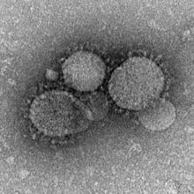
MERS-Middle Eastern Respiratory Syndrome
Coronavirus
Possible origin Egyptian Tomb Bats
Carried by Camels
First reported in Saudi Arabia
In 2012
MERS can be spread by close contact (caregivers)
MERS can affect anyone
Interim Guidance: http://www.cdc.gov/coronavirus/mers/interim-guidance.html

Slide 24
MERS
9 counties with confirmed cases
11 countries with travel-related cases
All reported cases have been linked to countries in and near the Arabian Peninsula.
As of May, 536 confirmed cases, 114 deaths
2 confirmed US cases-no transfer to others

Slide 25
The Impact of Drug Resistance
Drug resistant pathogens are a growing threat to ALL people
Every year, nearly 2 million patients in the US get an infection in a hospital
Of those, nearly 90,000 die as a result of their infection
More the 70% of the bacteria that cause HAIs are resistant to at least one drug commonly used to treat
Linked to longer hospital stays, use of more toxic drugs, poorer patient outcomes, more expense
CDC Campaign*
Notes:
CDC Campaign to Prevent Antimicrobial Resistance in Healthcare Settings
Stories from the field-what resistant infections issues concern you the most?

Slide 26
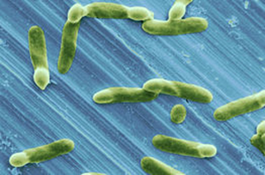
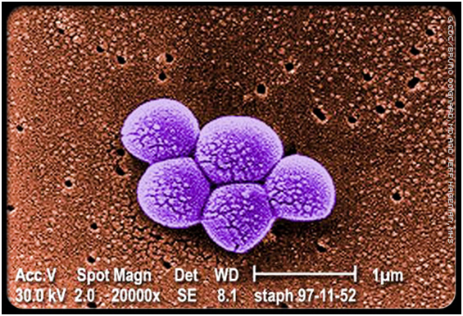
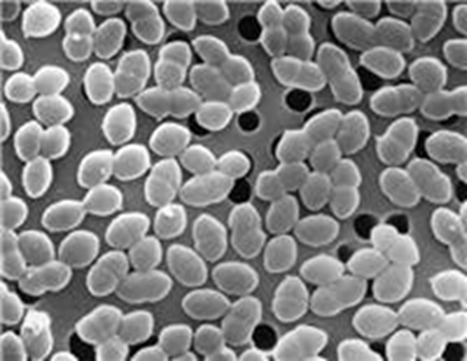
Resistant infections
MRSA, C. Difficile , VRE and Carbapenem-resistant Enterobacteriacea(CRE) all infections of concern
New protocols and guidance for CRE and C. Diff
New drug approved for MRSA-one mega-dose
C. Difficile
MRSA
CRE

Slide 27
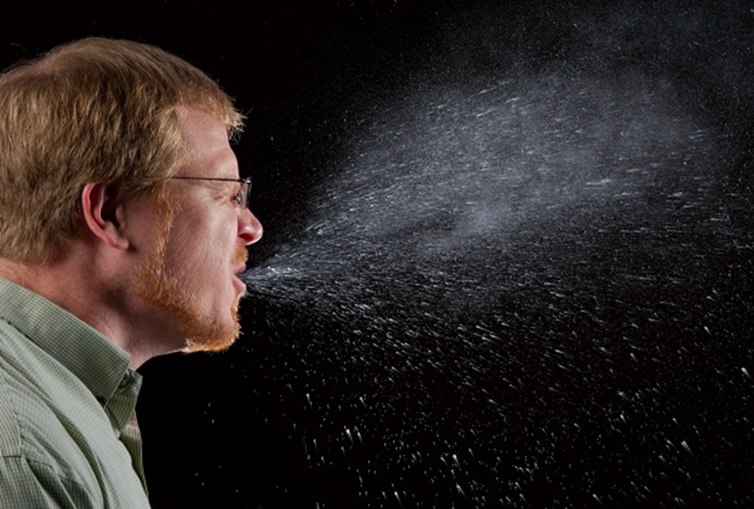
Infectious disease rule sent to SBREFA
Small business panel to convene
Workplaces that may be affected include: health care, emergency response, correctional facilities, homeless shelters, drug treatment programs, and other occupational settings where employees can be at increased risk of exposure to potentially infectious people
Request for small entity representatives to provide information
Notes:
Small Business Regulatory Enforcement Fairness Act, or SBREFA

Slide 28
23rd Death on the Job Report- statistics of interest
Fatality rate in 2012 3.4 deaths per 100,00 workers
North Dakota had the highest rate-17.7 mostly due to rapid expansion of oil and gas extraction
Latino workers have a higher rate of fatalities than the national average
MSD are increasing and now account for 34.7% of all serious injuries
Workplace violence: 24,610 serious injuries and 803 deaths. Women workers suffer 2/3 of injuries related to workplace violence

Slide 29
How does health and safety fit into the four Pillars ?

Slide 30
Discussion-what steps can we take to get members involved and build capacity?

Slide 31
Thanks for Coming! Enjoy Convention!

